Slide 1
Cyber Security And Cyber Laws

Slide 2
Unit IV

Slide 3
Cyber Laws
Cyber Law Cyber Law is the law governing cyber space.
Cyber space is a very wide term and includes computers, networks, software, data storage devices.
Law holds the rules of conduct : That have been approved by the government, which are in force over a certain territory, and which must be obeyed by all persons on that territory.

Slide 4
Cyber Laws
Need For Cyber Law Cyberspace is an limitless dimension that is impossible to govern and regulate using conventional law.
Cyberspace is absolutely open for participation by all.

Slide 5
Cyber Laws
A software source code worth crores of rupees or a movie can be pirated across the globe within hours of their release.
Hence, to stop this type of crime and to govern the cyber space, various cyber laws were made.

Slide 6
Cyber Laws
CYBER LAWS IN INDIA
  • The Information Technology Act, 2000
  • The Information Technology (Amendment) Act, 2008

Slide 7
Cyber Laws
The Information Technology Act (2000) The primary source of cyber law in India is the Information Technology Act, 2000 (IT Act) which came into force on 17 October 2000.
The primary purpose of the Act is to provide legal recognition to electronic commerce and to facilitate the filing of electronic records with the Government.

Slide 8
Cyber Laws
The IT act also penalizes various cyber crimes and provides strict punishments (imprisonment terms upto 10 years and compensation up to Rs.1 crore).
Information Technology (Certifying Authority) Regulations, 2001 came into force on 9 July 2001.
They provide further technical standards and procedures to be used by a Certifying Authority.

Slide 9
The Information Technology (Amendment) Act, 2008
The Government of India has brought major amendments to ITA-2000 in form of the Information Technology Amendment Act, 2008.
ITAA 2008 (Information Technology Amendment Act 2008) as the new version of Information Technology Act 2000 is often referred has provided additional focus on Information Security.
It has added several new sections on offences including Cyber Terrorism and Data Protection.
A set of Rules relating to Sensitive Personal Information and Reasonable Security Practices (mentioned in section 43A of the ITAA, 2008) was released in April 2011.

Slide 10
Cybercrime Categories
Cybercrime in a restrictive sense (computer crime): It is referred to any illegal behaviour that is carried out by means of electronic methods targeting the security of computer systems and the data processed by them. Th is can be considered as a narrow definition of the term cybercrime.
Cybercrime in a general sense (computer-related crime): It is referred to any illegal behavior that is committed by means of, or in relation to, a computer system or network, including such crimes as illegal possession, and offering or distributing information by means of a computer system or network. Th is can be considered as a broader definition of the term cybercrime.

Slide 11
computer trespass
Temporarily or permanently remove computer data, computer programs or computer software from a computer or computer network;
Cause a computer to malfunction regardless of how long the malfunction persists;
Alter or erase any computer data, computer programs or computer software;
Eff ect the creation or alteration of a financial instrument or of an electronic transfer of funds;
Cause physical injury to the property of another; or make or cause to be made an unauthorized copy, in any form.

Slide 12
Cybercrime and the Legal Landscape around the World
When we consider challenges involved in the Asia-Pacific region, for handling cybercrime, we realize that the challenges exist mainly due to the general lack of awareness of information security issues, the rapidly evolving complexity, capacity and reach of ICT, the anonymity afforded by these technologies and the transnational nature of communication networks.
Th e Australian Cybercrime Act 2001 came into eff ect in Australia in April 2002. Th is was the third time that a Federal

Slide 13
Cybercrime Act Australia 2001
The serious offenses under Division 477 are as follows:
• Section 477.1 Unauthorized access, modified cation or impairment with intent to commit a serious offense.
• Section 477.2: Unauthorized modified cation of data to cause impairment.
• Section 477.3: Unauthorized impairment of electronic communication.

Slide 14
Restricted data: In order for data to be defined as restricted, it simply needs to be held in a computer that uses an access control system.
Authorization: A key requirement for conviction, under any of the Division 477 offenses and half of the Division 478 offenses, is that access, modification or impairment is undertaken without “authorization.”

Slide 15

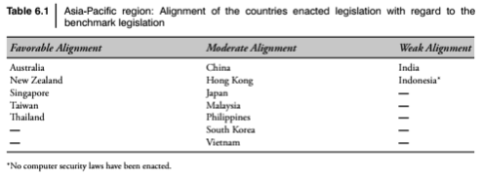

Slide 16
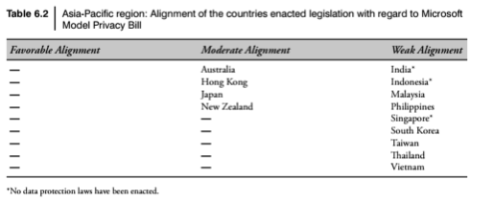

Slide 17
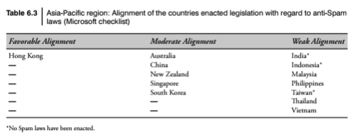
Spam Laws

Slide 18
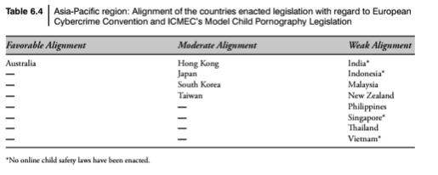
Online protection for Children

Slide 19
Canadian Legeslatives
Senate Bill S-220: Th e bill was introduced by Senator Yoine Goldstein in early February 2009. It is slated to become the Anti-Spam Act. It is a private member’s bill with private right of action and criminal remedies.
Parliamentary Bill C-27: Th ebill was tabled by the government in April 2009, with private right of action, coordination between various enforcement agencies, civil remedies. Th e Electronic Commerce Protection Act (ECPA)

Slide 20
ITA 2000
Indian ITA 2000 are relevant to the discussion of cybercrime in legal context. Th e relevant portion from that is as follows:
Section 65: Tampering with computer source documents.
Section 66: Computer-related offences
Section 67: Punishment for publishing or transmitting obscene material in electronic form. Section 72: Penalty for breach of confidentiality and privacy 6.
Section 73: Penalty for publishing Digital Signature Certificate false in certain particulars

Slide 21
Ammendenents in ITA 2000
The Second Schedule of the Indian ITA 2000: Amendment to the Indian Evidence Act 1.
In Section 3: (a) In the definition of “Evidence,” for the words “all documents produced for the inspection of the Court,” the words “all documents including electronic records produced for the inspection of the Court” shall be substituted;
(b) after the definition of “India,” the following shall be inserted, namely, the expressions “Certifying Authority,” “digital signature,” “Digital Signature Certificate,” “electronic form,” “electronic records,” “information,” “secure electronic record,” “secure digital signature” and “subscriber” shall have the meanings, respectively, assigned to them in the Information Technology Act 2000.

Slide 22
Ammendements in ITA 2000
In Section 17, for the words “oral or documentary,” the words “oral or documentary or contained in electronic form” shall be substituted.
After Section 22, the following section shall be inserted, namely, when oral admission as to contents of electronic records is relevant. “22A. Oral admissions as to the contents of electronic records are not relevant, unless the genuineness of the electronic record produced is in question.”
In Section 34, for the words “Entries in the books of account,” the words “Entries in the books of account, including those maintained in an electronic form” shall be substituted.

Slide 23
Ammendements in ITA 2000
In Section 35, for the word “record,” in both the places where it occurs, the words “record or an electronic record” shall be substituted.
For Section 39, the following section shall be substituted, namely, What evidence to be given when statement forms part of a conversation, document, electronic record, book or series of letters or papers. After Section 47, the following section shall be inserted, namely, Opinion as to digital signature where relevant.
In Section 59, for the words “contents of documents” the words “contents of documents or electronic records” shall be substituted.
After Section 65, the following sections shall be inserted, namely, Special provisions as to evidence relating to electronic record.

Slide 24
Admissibility of Electronic Records
65B:
Notwithstanding anything contained in this Act, any information contained in an electronic record which is printed on a paper, stored, recorded or copied in optical or magnetic media produced by a computer (hereinafter referred to as the computer output) shall be deemed to be also a document, if the conditions mentioned in this section are satisfied in relation to the information and computer

Slide 25
The Third Schedule of the Indian IT Act 2000: Amendment to the Bankers’ Books Evidence Act
In Section 2:
For Clause (3), the following clause shall be substituted, namely, ‘(3) “bankers’ books” include ledgers, day-books, cash-books, account-books and all other books used in the ordinary business of a bank whether kept in the written form or as printouts of data stored in a floppy, disc, tape or any other form of electro-magnetic data storage device;
For Clause (8), the following clause shall be substituted, namely, ‘(8) “certified copy” means when the books of a bank:

Slide 26
The Third Schedule of the Indian IT Act 2000: Amendment to the Bankers’ Books Evidence Act
After Section 2, the following section shall be inserted, namely, Conditions in the printout.
“2A. A printout of entry or a copy of printout referred to in subsection (8) of Section 2 shall be accompanied by the following, namely,
A certificate to the effect that it is a printout of such entry or a copy of such printout by the principal accountant or branch manager and
A certificate by a person in-charge of computer system containing a brief description of the computer system and the particulars of:

Slide 27
The Third Schedule of the Indian IT Act 2000: Amendment to the Bankers’ Books Evidence Act
The safeguards adopted by the system to ensure that data is entered or any other operation performed only by authorized persons;
The safeguards adopted to prevent and detect unauthorized change of data;
The safeguards available to retrieve data that is lost due to systemic failure or any other reasons;

Slide 28
The Fourth Schedule of the Indian IT Act 2000:
Amendment to the Reserve Bank of India Act In the Reserve Bank of India Act 1934, in Section 58, in subsection (2), after Clause (p), the following clause shall be inserted, namely, “the regulation of fund transfer through electronic means between the banks or between the banks and other financial institutions referred to in Clause (c) of Section 45-1, including the laying down of the conditions subject to which banks and other financial institutions shall participate in such fund transfers, the manner of such fund transfers and the rights and obligations of the participants in such fund transfers.

Slide 29
Positive Aspects of the ITA 2000
Prior to the enactment of the ITA 2000 even an E-Mail was not accepted under the prevailing s tatutes of India as an accepted legal form of communication and as evidence in a court of law. But the ITA 2000 changed this scenario by legal recognition of the electronic format. Indeed, the ITA 2000 is a step forward.
From the perspective of the corporate sector, companies are able to carry out E-Commerce using the legal infrastructure provided by the ITA 2000. Till the coming into eff ect of the Indian cyberlaw, the growth of E-Commerce was impeded in our country basically because there was no legal infrastructure to regulate commercial transactions online.

Slide 30
Positive Aspects of the ITA 2000
Corporate will now be able to use digital signatures to carry out their transactions online. Th ese digital signatures have been given legal validity and sanction under the ITA 2000.
In today’s scenario, information is stored by the companies on their respective computer system, apart from maintaining a backup. The remedy provided by the ITA 2000 is in the form of monetary damages, by the way of compensation, not exceeding ` 10,000,000.
ITA 2000 defined various cybercrimes. Prior to the coming into eff ect of the Indian Cyberlaw, the corporate were helpless as there was no legal redress for such issues.

Slide 31
Weak Areas of the ITA 2000
The ITA 2000 is likely to cause a conflict of jurisdiction.
E-Commerce is based on the system of domain names. Th e ITA 2000 does not even touch the issues relating to domain names.
The ITA 2000 does not deal with issues concerning the protection of Intellectual Property Rights (IPR) in the context of the online environment.
As the cyberlaw is evolving, so are the new forms and manifestations of cybercrimes. The offenses defined in the ITA 2000 are by no means exhaustive.
The ITA 2000 has not tackled vital issues pertaining

Slide 32
Weak Areas of the ITA 2000
The Information Technology Act is not explicit about regulation of Electronic Payments, and avoids applicability of IT Act to Negotiable Instruments.
IT Act does not touch upon antitrust issues.
The most serious concern about the Indian Cyberlaw relates to its implementation. The ITA 2000 does not lay down parameters for its implementation. Also, when Internet penetration in India is extremely low and government and police officials, in general, are not very computer savvy, the new Indian cyberlaw raises more questions than it answers.

Slide 33
Digital Signatures and the Indian IT Act
In this section, some potential problems regarding the terms digital signatures and electronic signatures are discussed.
Public-key certificate and the role of public-key infrastructure (PKI) are also explained.
Impact of oversights in ITA 2000 regarding digital signatures is also discussed

Slide 34
Public-Key Certificate
A public-key certificate is a digitally signed statement from one entity, saying that the public key (and some other information) of another entity has some specific value.
A digital signature is a type of electronic signature that is used to guarantee the integrity of the data.
When linked to the identity of the signer – using a security token such as X.509 Certificates – a digital signature can be used for non-repudiation
X.509 version information;
a serial number that uniquely identifies the certificate;
A common name that identifies the subject;
The public key associated with the common name;
The name of the user who created the certificate, known as the subject name; 6. information about

Slide 35
Representation of Digital Signatures in the ITA 2000
ITA 2000 had prescribed digital signatures based on Asymmetric cryptosystem and Hash system as the only acceptable form of authentication of electronic documents recognized as equivalent to “signatures” in paper form.
When the ITA 2000 was drafted, there was a slip-up in the drafting of Section 35, subsection (3), which made it mandatory for an applicant of a digital signature certificate to enclose a Certification Practice Statement along with his application. One of the major deficiencies in the bill, which could hinder implementation.

Slide 36
Impact of Oversights in ITA 2000
To keep the situation under control, the Ministry of Information and Technology had to urgently establish a task force to assist them in the drafting of the rules.
The task force consisted of experts in the field.
The Information Technology Amendment Bill 2006 was drafted on the basis of the recommendations of an “Expert Committee.”
Th e Committee took into consideration a recommendation from technical community that (a) the PKI-based system made the law dependent on a single authentication technology and (b) there was a need to make the law Technology Neutral.

Slide 37
Implications for Certifying Authorities
Section 3A:
Electronic Signature
Notwithstanding anything contained in Section 3, but subject to the provisions of subsection
A subscriber may authenticate any electronic record by such electronic signature or electronic authentication that
  (a) is considered reliable and
  (b) may be specified in The Second Schedule.

Slide 38
For the purposes of this section any electronic signature or electronic authentication technique shall be considered reliable if
The signature creation data or the authentication data are, within the context in which they are used, linked to the signatory or, as the case may be, the authenticator and of no other person
The signature creation data or the authentication data were, at the time of signing, under the control of the signatory or, as the case may be, the authenticator and of no other person
Any alteration to the electronic signature made after affixing such signature is detectable;
Any alteration to the information made after its authentication by electronic signature is detectable and
It fulfills such other conditions which may be prescribed.

Slide 39
Implications for Certifying Authorities
The Central Government may prescribe the procedure for the purpose of ascertaining whether electronic signature is that of the person by whom it is purported to have been affixed or authenticated.
The Central Government may, by notification in the Official Gazette, add to or omit any electronic signature or electronic authentication technique and the procedure for affixing such signature from the Second Schedule.
Every notification issued under subsection
Shall be laid before each House of Parliament.

Slide 40
Non-repudation
Th ere are two following definitions for the term non-repudiation:
Definition 1 (General): The intent to accept one’s obligation under a contract and be bound for its performance.
Definition 2 (E-Commerce): The intent to accept responsibility of submitting or receiving an electronic message and to be bound by its substance.

Slide 41
Amendments to the Indian IT Act
According to some experts, Indian law may satisfy European Union’s data protection concerns.
To support the development of the cybersecurity infrastructure, the amendments also focus on
Defining penalties for violation.
Defining appropriate level of compensation
Setting up an authority for implementation.

Slide 42
Overview of Changes Made to the Indian IT Act
Section 66B of the Amended IT Act of India
It states punishment for dishonestly receiving stolen computer resource or communication device “Whoever dishonestly receives or retains any stolen computer resource or communication device knowing or having reason to believe the same to be stolen computer resource or communication device shall be punished with imprisonment of either description for a term which may extend to three years or with fine which may extend to rupees one lakh or with both

Slide 43
Cyberforensics
Provides digital evidence of a specific or general activity
Key role in investigation of cybercrime
“Evidence” in the case of “cyberoffenses”
Handling of the digital forensics evidence
Computer is either the subject or the object of cybercrimes or is used as a tool to commit a cybercrime
.

Slide 44
Computer Forensics
Related to the use of analytical and investigative techniques to identify, collect, examine and preserve evidence/information which is magnetically stored or encoded.
The lawful and ethical seizure, acquisition, analysis, reporting and safeguarding of data and metadata derived from digital devices which may contain information that is notable and perhaps of evidentiary value to the trier of fact in managerial, administrative, civil and criminal investigations. In other words, it is the collection of techniques and tools used to find evidence in a computer.

Slide 45
Computer Forensics (or Digital Forensics)
Digital evidence is required
A fast-growing profession as well as business
Computer security and computer forensics are different from each other.
The use of scientifically derived and proven methods toward the preservation, collection, validation, identification, analysis, interpretation, documentation and presentation of digital evidence derived from digital sources for the purpose of facilitating or furthering the reconstruction of events found to be criminal, or helping to anticipate unauthorized actions shown to be disruptive to planned operations

Slide 46
Digital Forensics Science
Application of analyses techniques to the reliable and unbiased collection, analysis, interpretation and presentation of digital evidence.
The use of scientifically derived and proven methods toward the preservation, collection, validation, identification, analysis, interpretation, documentation and presentation of digital evidence derived from digital sources for the purpose of facilitation or furthering the reconstruction of events found to be criminal, or helping to anticipate unauthorized actions shown to be disruptive to planned operations.

Slide 47
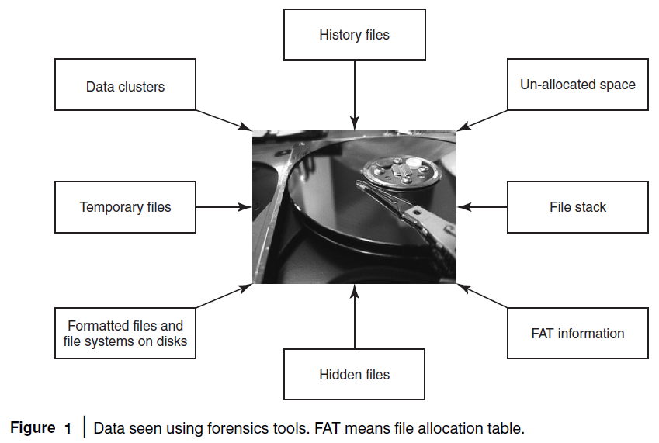

Slide 48
Need for Computer Forensics
Convergence of ICT advances and the pervasive use of computers worldwide
High technical capacity of modern computers/computing devices
New risks for computer users
Widespread use of computer forensics is the result of:
Increasing dependence of law enforcement on digital evidence
Ubiquity of computers that followed from the microcomputer revolution

Slide 49
Evidence
Everything that is used to determine or demonstrate the truth of an assertion.
Can be used in court to convict people who are believed to have committed crimes.
Handle carefully.

Slide 50
Cyberforensics and Digital Evidence
Computer forensics
Network forensics
Computer forensics experts know the techniques to retrieve the data from files listed in standard directory search, hidden files, deleted files, deleted E-Mail and passwords, login IDs, encrypted files, hidden partitions, etc. Typically, the evidences reside on computer systems, user created files, user protected files, computer created files and on computer networks

Slide 51
The Rules of Evidence
According to the “Indian Evidence Act 1872,” “Evidence” means and includes:
All statements which the court permits or requires to be made before it by witnesses, in relation to matters of fact under inquiry, are called oral evidence.
All documents that are produced for the inspection of the court are called documentary evidence.

Slide 52
Forensics Analysis of E-Mail
It helps establish the authenticity of an E-Mail when suspected.
E-Mails -- the most common means of communication.
The subject of forensics analysis for “digital evidence.”
E-Mail System
The hardware and software that controls the flow of E-Mail.
Components
E-Mail server
E-Mail gateway
Forensics Analysis of E-Mail
It helps establish the authenticity of an E-Mail when suspected.
E-Mails -- the most common means of communication.
The subject of forensics analysis for “digital evidence.”

Slide 53
Digital Forensics Life Cycle
As per FBI’s (Federal Bureau of Investigation) view, digital evidence is present in nearly every crime scene. That is why law enforcement must know how to recognize, seize, transport and store original digital evidence to preserve it for forensics examination.
Digital Forensics Process
Digital forensics evidence consists of exhibits.
The exhibits are introduced as evidence by either side.
Testimony is presented to establish the process.
The party must show the evidence.
Digital forensics evidence can be challenged.
Forensics experts formulate a cost proposal.
Proposed timeline of activities, lists of anticipated deliverables and a plan for production and turnover of evidence.
Submission of a preliminary risk analysis for the forensics service being proposed.

Slide 54
Phases in Computer Forensics/Digital Forensics
1. Preparation and identification
2. Collection and recording
3. Storing and transporting
4. Examination/investigation
5. Analysis, interpretation and attribution
6. Reporting
7. Testifying

Slide 55
Collecting and Recording Digital Evidence
Sources
Computers
Cell phones
Digital cameras
Hard drives
CD-ROM
USB memory devices
Digital thermometers
Black boxes inside automobiles
RFID tags and webpages

Slide 56
Storing and Transporting Digital Evidence
1. Image computer media using a write-blocking tool to ensure that no data is added to the suspect device
2. Establish and maintain the chain of custody
3. Document everything that has been done
4. Only use tools and methods that have been tested and evaluated to validate their accuracy and reliability.
5. Care must be taken in transportation to prevent spoliation (in a hot car, digital media tends to lose bits).
6. Care must be taken to preserve chain of custody and assure that a witness can testify accurately about what took place.

Slide 57
Intellectual Property
Intellectual Property (IP) simply refers to the creation of the mind.
It refers to the possession of thought or design by the one who came up with it.
It offers the owner of any inventive design or any form of distinct work some exclusive rights, that make it unlawful to copy or reuse that work without the owner’s permission.
It is a part of property law. People associated with literature, music, invention, etc. can use it in business practices.
There are numerous types of tools of protection that come under the term “intellectual property”.
Notable among these are the following:
Patent
Trademark
Geographical indications
Layout Designs of Integrated Circuits
Trade secrets
Copyrights
Industrial Designs

Slide 58
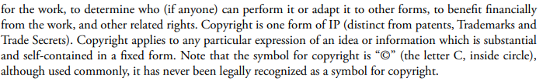
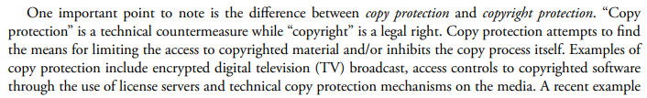

Copyright

Slide 59
Copyright Infringement:
Copyright protection is given to the owner of any published artistic, literary, or scientific work over his work to prohibit everyone else from exploiting that work in his name and thereby gain profit from it.
When these proprietary creations are utilized by anyone without the permission of the owner, it leads to copyright infringement.
If copies of any software are made and sold on the internet without the permission of the owner or even copying the content from any online source, these all are examples of copyright infringement.

Slide 60
Copyright Issues in Cyberspace
1. Linking –
It permits a Website user to visit another location on the Internet.
By simply clicking on a word or image on one Web page, the user can view another Web page elsewhere in the world, or simply elsewhere on the same server as the original page.
Linking damages the rights or interests of the owner of the Linked webpage.
It may create the supposition that the two linked sites are the same and promote the same idea.
In this way, the linked sites can lose their income as it is often equal to the number of persons who visit their page.

Slide 61
Software Piracy
Software piracy refers to the act of stealing software that is lawfully shielded. This stealing comprises various actions like copying, spreading, altering, or trading the software. It also comes under the Indian copyright act.
An example of software piracy is downloading a replica of Microsoft Word from any website other than Microsoft to avoid paying for it as it is a paid software. Piracy can be of 3 types:
Soft lifting
Software Counterfeiting
Uploading-Downloading.

Slide 62
Cybersquatting
Cybersquatting means unauthorized registration and use of Internet domain names that are similar to any business’s trademarks, service marks, or company names.
A cybersquatter could buy xyz.com, looking to sell the domain to the company Xyz at a later date for a profit.
The domain name of a famous company can even be used to attract traffic and this traffic will help cybersquatters earn a lot of money through advertising.
When more than one individual believes that they have the right to register a specific domain name, then this can lead to a Domain Name Dispute.
It arises when a registered trademark is registered by another individual or organization who is not the owner of a trademark that is registered.

Slide 63
Jurisdiction Issues And Copyright infringement
A person residing in country A takes a work by an artist in country B and puts it onto a website they own but which is hosted in country C which is intended for an audience of people in country D.
The artist in country B did not give permission for this and wants to pursue legal actions.
It is likely that the proper law will be that of A or C. This depends on a number of factors:
Whether the infringing party profited from the infringement.
If the infringing party profited from the act, then you are likely to want to bring the matter in A, so that you can recover damages.
Whether the infringing party has any presence in B.
If the party has a presence in B, then a claim in B is likely to be more cost-effective.
Again, depending on the laws of the country, it may not be possible for the artist to bring a claim against the infringing party if they have no local presence. Some countries have laws that explicitly allow extraterritorial service.

Slide 64
Jurisdiction Issues And Copyright infringement
Whether the hosting service was aware of the copyright infringement.
If the hosting service was aware of the infringement and failed to prevent it, then you may be able to claim for contributory infringement - they could then, depending on their contract/agreement with the infringing party, be able to claim for damages. The Napster case may be somewhat relevant to this, but it's hard to say anything concrete when working with hypothetical countries.
At the very least, a claim against the hosting service - which may just be an injunction ordering the removal of the content - could be fruitful.
The actual laws of the countries involved.
If the artist has sufficient money, they can just choose the forum that is most favourable to them.

Slide 65
Multimedia And infringement
The emergence of digital technologies towards the concluding decades of the twentieth century raised a whole new set of challenges to copyright regimes.
• The traditional notions of the basic concepts such as rights of reproduction and distribution have become inadequate and even irrelevant in the digital age.
• All works can now be digitalized whether they comprise texts, images, sound or diagrams and once digitalized the various elements such as images are all 'equal' and can be merged, transformed, manipulated or mixed to create an endless variety of new works.
• Earlier rights of reproduction distribution affected tangible physical copies only of a work.
• The new technologies brought in non-material and distribution.
Physical reproductions were replaced by digital reproduction, which was easy as well as cost effective

Slide 66
Multimedia And infringement
The major objective of the copyright law is to strike out a balance between rights of the copyright holders and the general public.
• To achieve its objective, copyright has been amended with time to time so as to meet the requirements posed by the technological advancements.
• Indian Copyright Act has also been amended to counter the threats posed by the technological developments. The major changes in copyright legislation have been in response to advances in technology.
Since the development of internet, there have been major Amendments to the Copyright Act every two or three years.
• While protecting the Copyright owners these measures conflict with the legitimate rights of Copyright users. “The primary objective of copyright is not to reward the labor of authors, but to promote the Progress of Science and useful Arts.

Slide 67
WIPO
The World Intellectual Property Organisation or WIPO is a global body for the promotion and protection of Intellectual Property Rights (IPR).
It acts as a global forum for IP Services.
WIPO is a self-funded agency of the United Nations.
With 192 members, WIPO’s motto is to encourage creative activity, to promote the protection of intellectual property throughout the world.
It is at present headed by Francis Gurry, who is its Director-General. WIPO is headquartered in Geneva, Switzerland.
WIPO has its origins in the United International Bureaux for the Protection of Intellectual Property (BIRPI), which was established in 1893.
WIPO is dedicated to developing a balanced and accessible international Intellectual Property (IP) system, which rewards creativity, stimulates innovation and contributes to economic development while safeguarding the public interest.’

Slide 68
Functions of WIPO
The World Intellectual Property Organisation (WIPO) was established with the intent to perform the following functions:
To assist the development of campaigns that improve IP Protection all over the globe and keep the national legislations in harmony.
Signing international agreements related to Intellectual Property Rights (IPR) protection.
To implement administrative functions discussed by the Berne and Paris Unions.

Slide 69
Functions of WIPO
To render legal and technical assistance in the field of IP.
To conduct research and publish its results as well as to collect and circulate information.
To ensure the work of services that facilitate the International Intellectual Property Protection.
To implement other appropriate and necessary actions.

Slide 70
IPO and India
India joined the WIPO in 1975.
India is a part of the following WIPO Treaties:
IPO Convention (1975)
Paris Convention (1998)
Berne Convention (1928)
Patent Cooperation Treaty (1998)
Phonograms Convention (1975)
Nairobi Treaty (1983)
Nice Agreement (2019)
Locarno Agreement (2019)
Vienna Agreement (2019)

Slide 71
IPO and India
India has jumped places in the Global Innovation Index (GII) in recent years. In the 2019 GII, India is ranked 52nd, which is a big leap from previous years.
Since 2011, India is the top-ranked innovative country in the Southern and Central Asia region.
India has been outperforming on innovation relative to its GDP per capita for eight years at a stretch.
On innovation quality, India ranks second among middle-income economies globally.
The Confederation of Indian Industry (CII) is a GII Knowledge Partner since 2009.
In India, the Ministry of Commerce and Industry deals with WIPO and related issues.

Slide 72
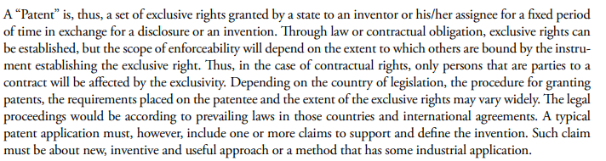
Patent

Slide 73
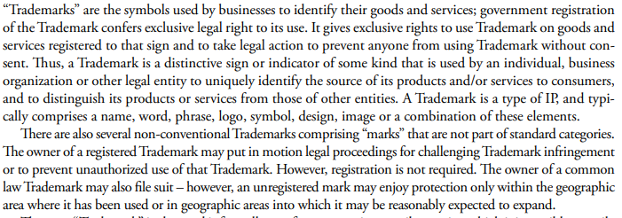
Trademark

Slide 74
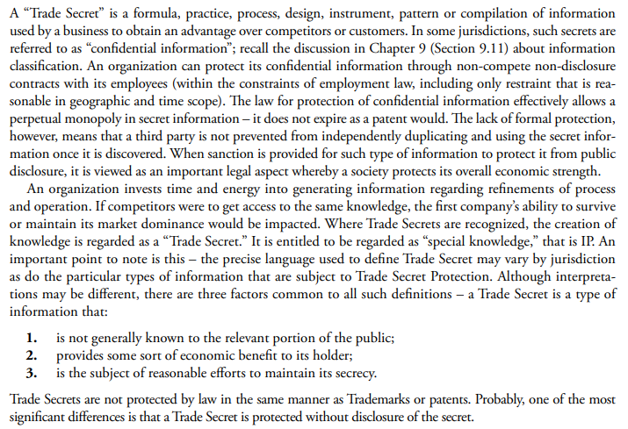
Trade Secret

Slide 75
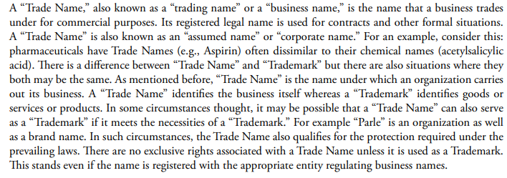
Trade Name

Slide 76
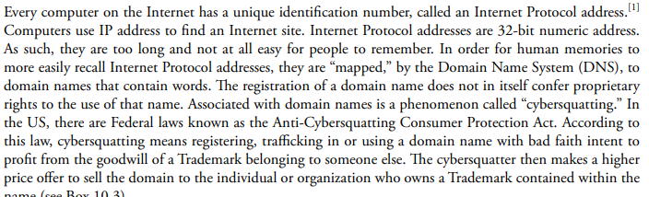
Domain Name Registration

Slide 77
Software Piracy
Software piracy is the unauthorized downloading, copying, use, or distribution of software.
Downloading and using software without paying for it is a common tactic of pirated software users.
However, software piracy also includes distributing software on multiple machines when a license was only purchased for one, as well as copying software and redistributing it.
Take a moment to learn more about what software piracy is, the ramifications of pirated software use, as well as how to spot and ultimately avoid pirated software when it crosses your path.

Slide 78
Authorship
Authorship of a scientific paper indicates that the authors should be credited with creation of new knowledge, offering new solutions, or providing novel insights.
It establishes the link between the new idea or discovery and its originator.
This is associated with rewards, material, and beyond.
The authors earn credit points in performance appraisals, for promotions in the organization, and for better positions elsewhere.
Authorship brings recognition from peers and experts in the field.
There are financial benefits to be reaped in the form of patents and grants for new research projects.
This way, authorship of a research paper has the potential of offering cascading material benefits.
No wonder, then, that, in the world of scholarship, authorship is very much sought after. The attractiveness of and value attached to authorship spur scientists to plan and execute research projects and publish them in reputed journals.
However, the very same factors also entice scientists to indulge in unethical behaviors and crave for authorship even when they do not deserve it. This communication intends to shed some light on some of these behaviors.

Slide 79
Forgery
Forgery is commonly thought of as the white collar crime of signing another person's name to a document, like forging signatures on a check, for instance.
But the actual definition of forgery is much more complicated than that, and the penalty for check fraud and the penalty for check forgery aren't as cut and dried, either.
Just within check forgery law, you can have several different types of forgery and fraud crimes, including filling in an amount on a signed check.
And forgery goes far beyond checks and bank notes. Creating, forging or altering almost any document, for the intent of fraud or making money, is considered forgery and is subject to state and sometimes federal laws and penalties for individuals caught forging federal documents.

Slide 80
Commonly Forged Documents
While checks are the forged document most people are aware of, there are many other types of documents and instruments that are commonly forged and counterfeited.
Checks
Money orders
Deeds
Titles
Securities
Bonds
Court Seals
Currency
Corporate documents
Documents used in identity theft

Slide 81
Forgery
Forgery is a type of fraud that carries many of the same penalties as counterfeiting because the three crimes often overlap. The penalty for forgery can vary a great deal depending on many factors, like the severity of the crime, the extent of the crime and whether or not it was committed on a national level. In any case, it is imperative to contact a criminal lawyer to defend these types of cases.
Most forgery cases are tried on a state level using state-mandated penalties. But forgery is also a federal offense, and in some circumstances the federal courts will try forgery cases.

Slide 82
Penalty for Forgery
How much money was to be gained through the forgery is the main factor in determining a penalty for the crime. A forgery that was intended to gain the forger thousands of dollars or more will carry much stiffer penalties than a forged $100 check. But even forgeries on a very small scale can be picked up by federal courts if they were done in more than one state, or on a document or instrument on a federal level, like a bond or security.

